Slide 1

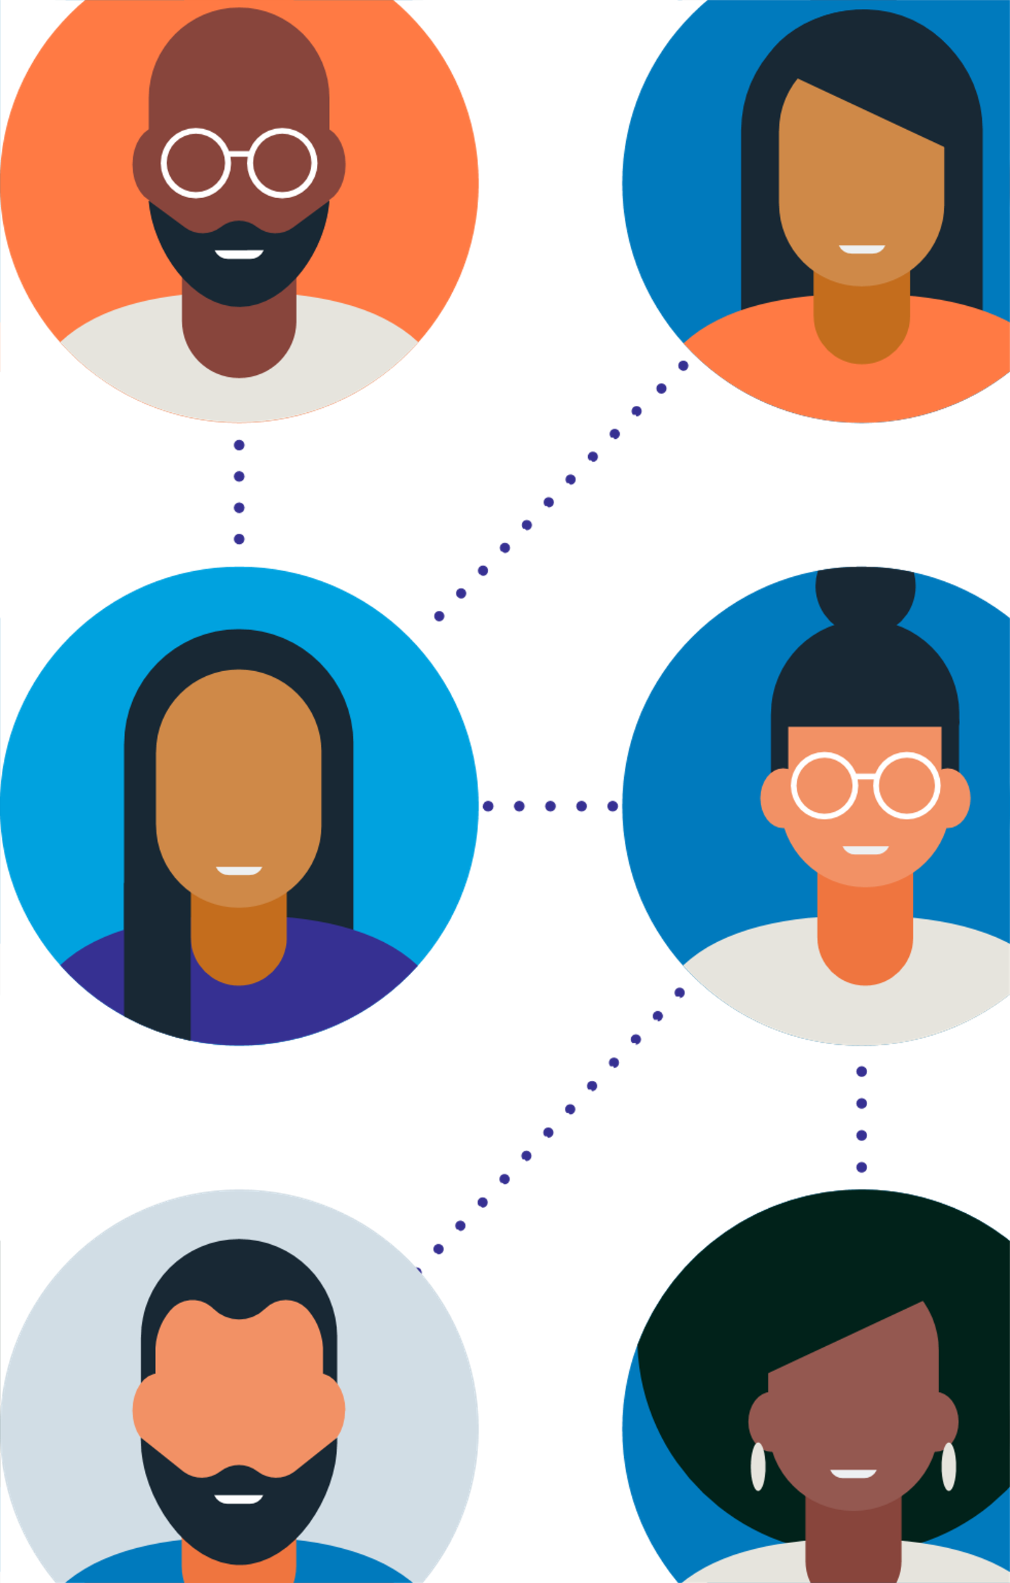
AUDIOBOOKIFY
Team Members:
1. Yuraja Kadari 2. Yash Jivani 3. Shrutika Gajbhiye 4. John Melo 5. Dipen Patel 6. Vicky Jadhav

Slide 2

AGENDA
Introduction
Business Objectives
Literature Analysis
Project Planning and Milestones
Product Development
Research Findings
Results
Future Prospects
Concluding Remarks
References

Slide 3

Introduction
Why Audiobookify?​
Addresses the pressing need for universal access to written content in the digital age, especially for the visually impaired.​
Responds to the urgent call for innovation in accessibility, acknowledging the significant challenges faced by millions worldwide in accessing written content.​
Offers a solution to bridge the accessibility gap by converting images and PDFs into audiobooks, catering to diverse reading preferences.​
What is Audiobookify?
An advanced application utilizing Optical Character Recognition (OCR) technology.
Seamlessly transforms text from images or PDFs into audio format.
Provides a user-friendly interface and intuitive functionality, enabling access to literature and educational materials conveniently and efficiently.
Key Objectives of Audiobookify
Empower visually impaired individuals to engage with written content autonomously, enriching their educational and recreational pursuits.
Foster inclusivity by accommodating individuals who prefer auditory learning, such as commuters or those with busy lifestyles.
Redefine the interaction between individuals and written material by offering a convenient alternative through audio format.

Slide 4
Business Objectives
Optical Character Recognition (OCR) Software
Text-to-Speech (TTS) Software
Programming Languages and Development Tools
Database Management Systems (DBMS)
Quality Assurance (QA) and Testing Tools
User Experience (UX) Design
Project Management and Collaboration Tools

Slide 5
Literature Analysis
The literature reviews for each module of our project, which encompasses various subsystems requiring extensive research:
Accessibility and Audiobooks
OCR Technology
PDF Text Extraction
Text-to-Speech (TTS) Systems
Legal and Ethical Considerations
These modules are integral components of our project and necessitate thorough investigation and analysis.
OCR Technology:
Reference: LeCun, Y., Bengio, Y., & Hinton, G. (2015). Deep learning. Nature, 521(7553), 436-444.
This paper discusses recent advancements in OCR technology, particularly focusing on deep learning-based approaches, neural network architectures, and domain-specific OCR systems, which are relevant for understanding the current trends and challenges in OCR research and development.
Text-to-Speech (TTS) Systems:
Reference: Wang, Y., Skerry-Ryan, R., Stanton, D., Wu, Y., Weiss, R. J., Jaitly, N., ... & Saurous, R. A. (2017). Tacotron: Towards End-to-End Speech Synthesis. arXiv preprint arXiv:1703.10135.
This paper introduces Tacotron, an end-to-end neural network model for text-to-speech synthesis, which represents a significant advancement in TTS technology. It provides insights into the architecture and challenges of neural TTS systems, offering valuable information for understanding recent developments in the field.

Slide 6
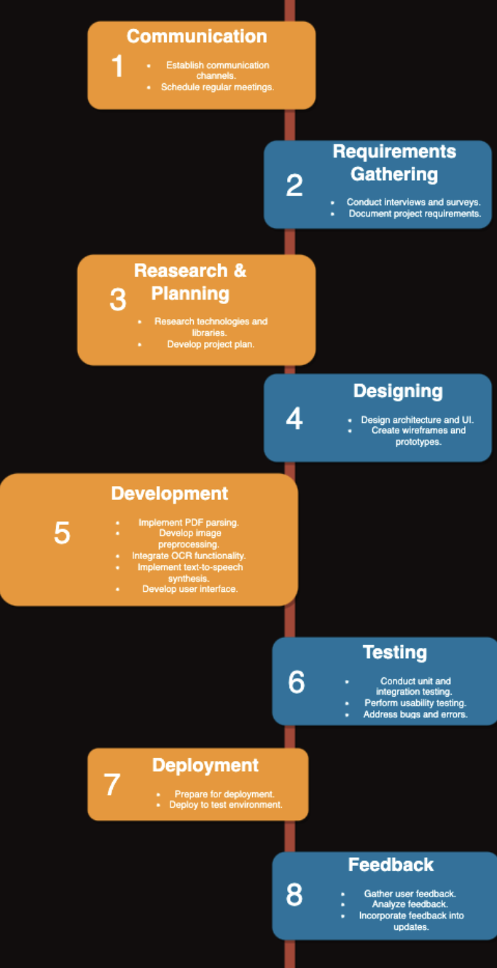
Project Planning and Milestones
We have chosen the Agile software development methodology for its iterative and incremental approach, allowing for flexibility and adaptability throughout the project lifecycle. Agile plan is given below:
Communication and Planning (Week 1-2):
Establish communication channels, define project goals, and conduct initial sprint planning.
Sprint 1 (Week 3-4):
Gather and analyze requirements, design initial architecture, and user interface.
Sprint 2 (Week 5-6):
Develop core functionalities such as PDF parsing and image preprocessing, and begin integrating OCRFunctionality.
Sprint 3 (Week 7-8):
Complete OCR integration and commence text-to-speech synthesis development.
Sprint 4 (Week 9-10):
Finish text-to-speech synthesis, initiate user interface development.
Sprint 5 (Week 11-12):
Conduct testing (unit, integration, usability), and address identified bugs or issues.
Sprint 6 (Week 13-14):
Deploy to test environment, gather user feedback.
Sprint 7 (Week 15-16):
Incorporate user feedback into updates, finalize deployment.

Slide 7
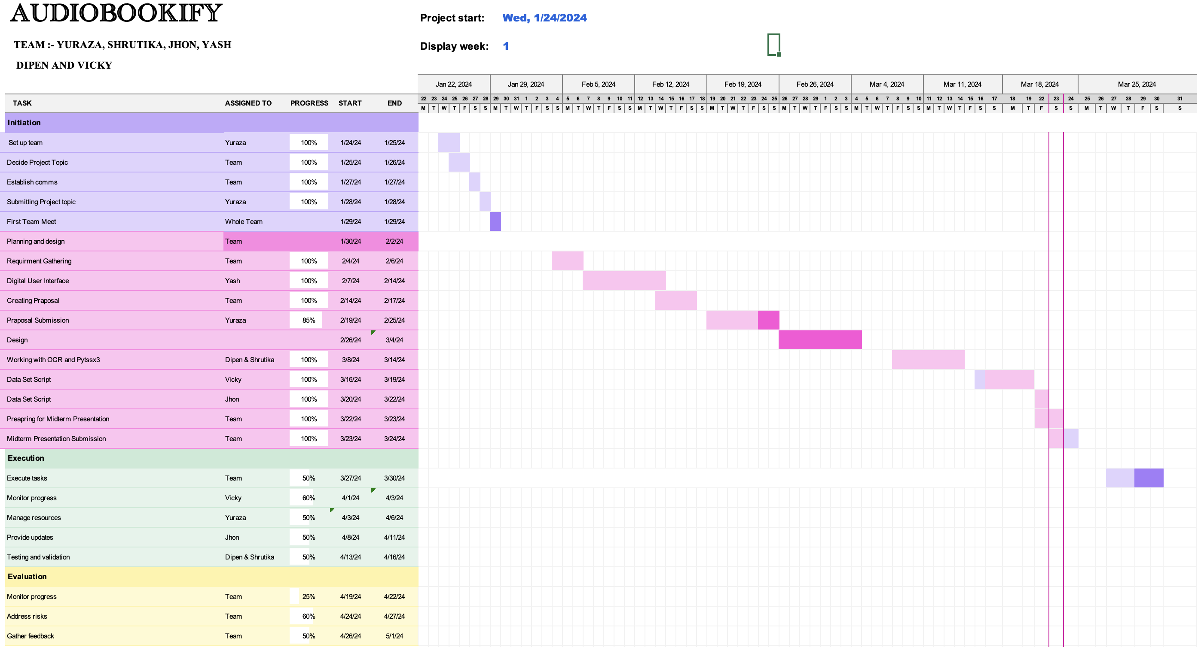
Gantt Chart:- The diagram below illustrates the project's status, timeline, achieved milestones, and delivery dates for deliverables.

Slide 8
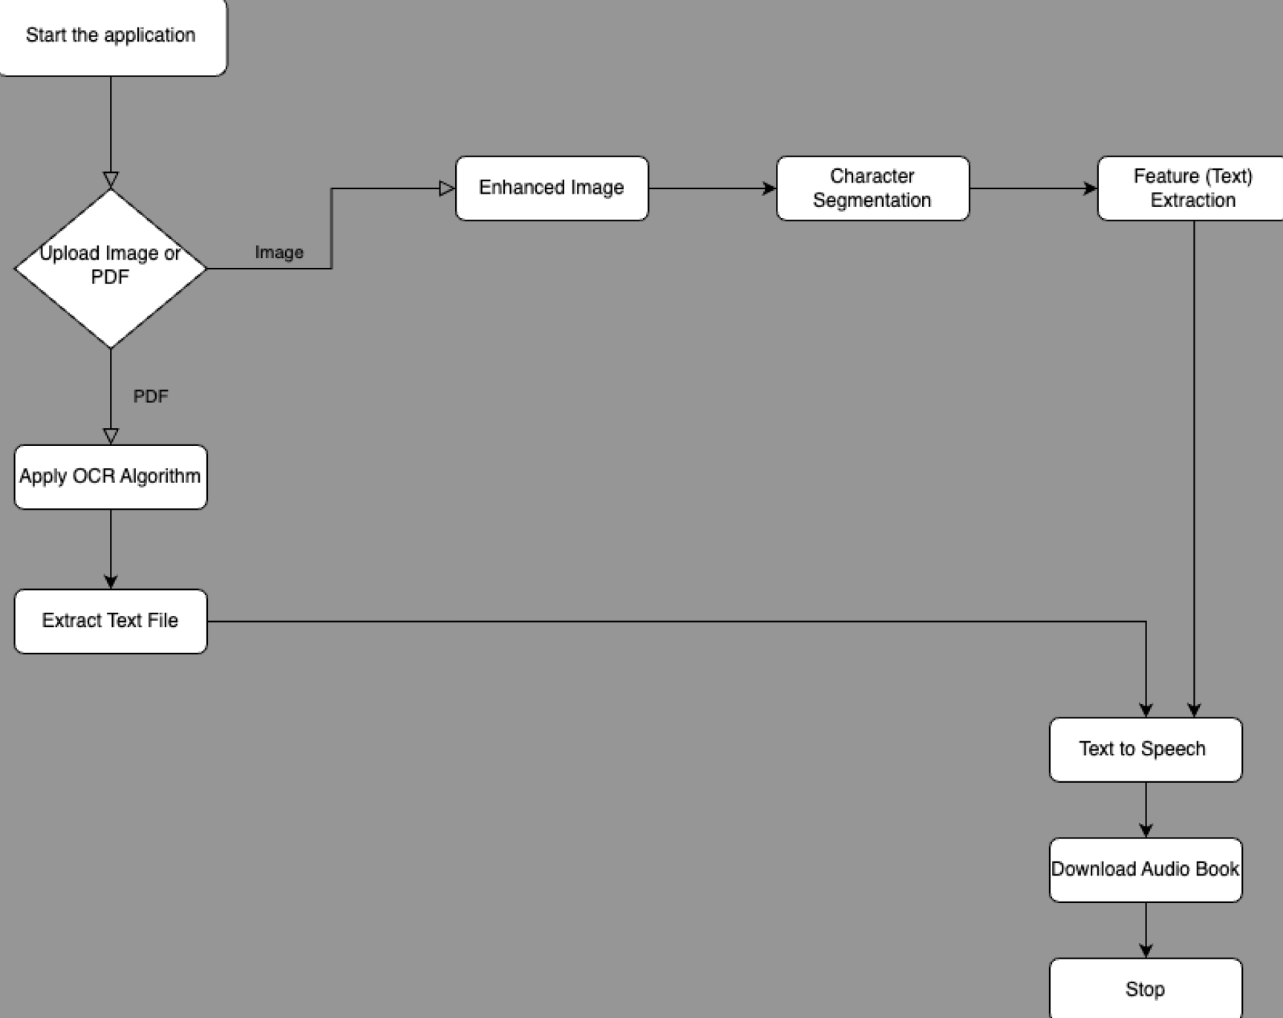
Product Development
Basic structure of the project has been developed:
Users can upload images or PDFs.
Our algorithm extracts text from both formats.
Extracted text is converted into a text file.
Once text files are generated:
The algorithm converts them into audio files.
This process results in the creation of an audiobook.
Next steps involve:
Enhancing the algorithm for better performance.
Testing the model rigorously.

Slide 9
Research Findings
Libraries or APIs for OCR | Language | Features | Drawbacks
Tesseract OCR | C++ | Open Source Supports various image formats Trainable for custom fonts | Requires preprocessing Accuracy depends on image quality
Google Cloud Vision API | REST API | Excellent accuracy Supports multiple language Integrated with GCP | Limited free tier Requires internet connectivity
Microsoft Azure Computer Vision | REST API | Good service Supports OCR in various languages Integrates with Azure services | Limited free tier Might have occasional inaccuracies
Amazon Textract | REST API | Part of AWS ecosystem Extract structured data Supports forms and tables | Costly for large-scale use Limited OCR languages
OpenCV | C++ | Open source Integrated with Python | Requires more preprocessing Not solely focused on OCR
Tesseract OCR is an open-source project maintained by Google. It offers flexibility in handling various input formats, including images with different resolutions, color depths, and formats (JPEG, PNG, TIFF, etc.). It supports training with custom fonts and languages, enabling users to create specialized OCR models for specific use cases or languages not covered by default.

Slide 10
Research Findings
Libraries or APIs for TTS | Language | Features | Drawbacks
gTTS (Google TTS) | Python | Free and Open-source library Supports wide range of languages | Limited control over voice parameters Requires specific licensing for commercial applications
pyttsx3 | Python | Free and Open-source library Allows control over speech parameters like rate, volume, and voice | Complex setup, requires to install dependencies Not ideal for professional use
Amazon Polly | REST API | Realistic speech synthesis Various languages and voices Part of AWS ecosystem | Costly for large-scale usage Limited customization
Microsoft Azure Text to Speech | REST API | High-quality voices Supports multiple languages and neural voices | Limited free tier Occasional robotic sounding output.
Both gTTS and pyttsx3 provide straightforward and easy-to-use interfaces for generating speech from text within Python scripts or applications.
pyttsx3 allows for offline text-to-speech conversion, leveraging installed TTS engines on the user's system, providing flexibility and independence from internet connectivity.
gTTS offers online text-to-speech conversion through Google's TTS service, suitable for applications requiring internet connectivity and advanced speech synthesis capabilities.

Slide 11
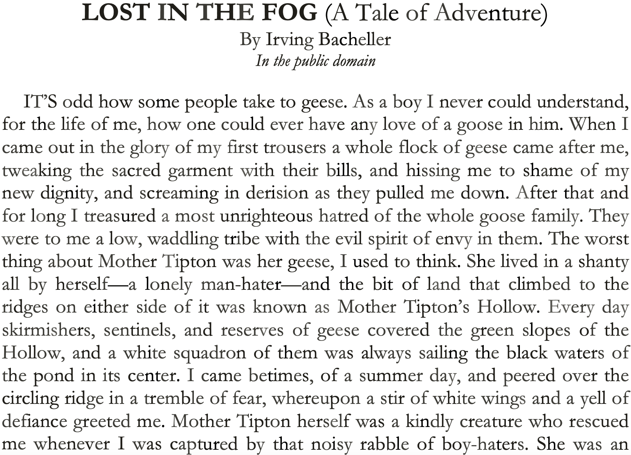
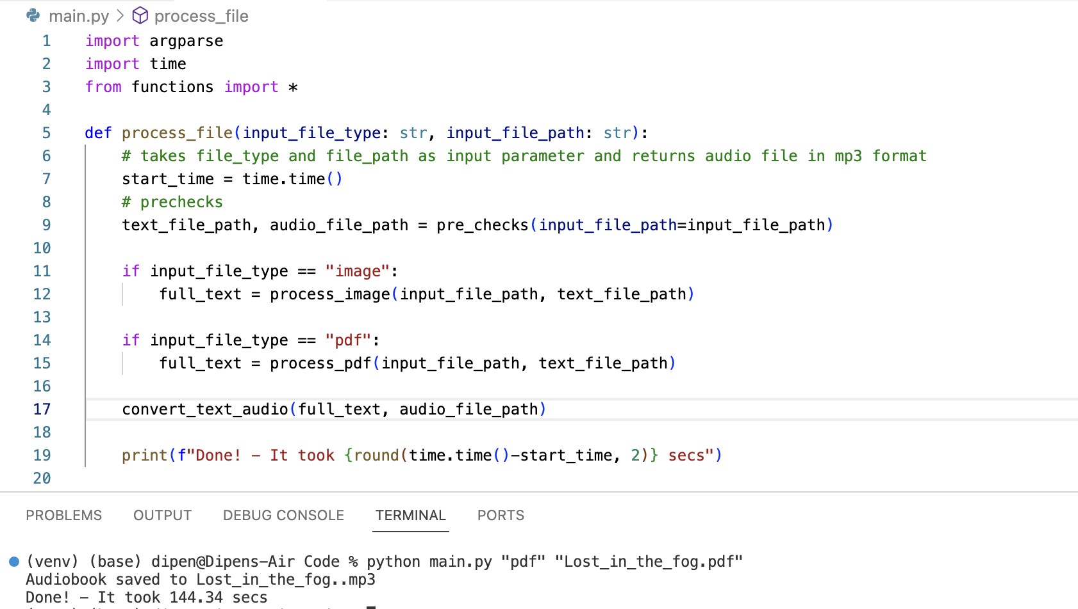
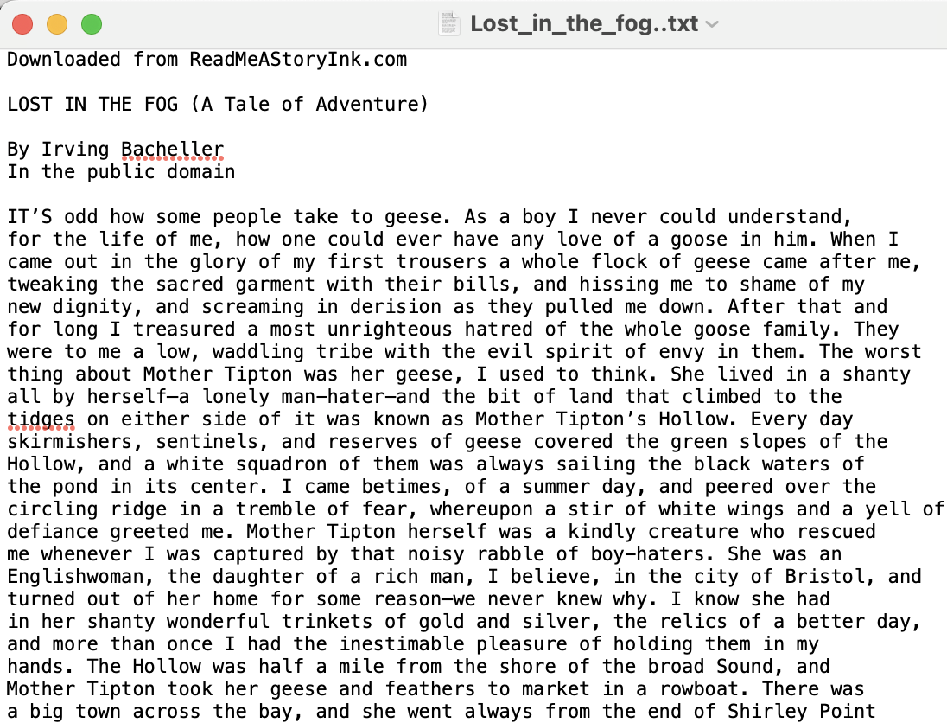
Results
We have successfully processed the 'Lost in the Fog' storybook through our system. The output consists of a text file and an audio (MP3) file. We have thoroughly verified the accuracy of the extracted text, confirming that all content was correctly recognized by our Optical Character Recognition (OCR) technology. Additionally, the audiobook has been stored locally.

Slide 12

Future Prospects
Advanced Audio Enhancement: Implement sophisticated audio processing techniques to improve the quality and realism of narrations in audiobooks, ensuring a more immersive listening experience for users.
Global Accessibility: Expand language support and incorporate translation features to make audiobooks accessible to users worldwide, catering to diverse linguistic preferences and enabling greater inclusivity.
Intelligent Content Management: Develop AI-driven algorithms to analyze and categorize audiobook content, enabling personalized recommendations, efficient content discovery, and seamless navigation through extensive libraries.
Enhanced User Experience: Focus on refining the user interface and user experience design, incorporating intuitive controls, customizable settings, and interactive features to optimize user engagement and satisfaction.
Scalable Infrastructure: Invest in scalable cloud infrastructure and distributed computing technologies to support the processing and storage needs of a growing user base, ensuring high performance and reliability even under heavy loads.

Slide 13

Concluding Remarks
Text-to-Speech technology has made audiobooks a staple resource for people with visual impairments.
The research and selection of appropriate OCRs is an imperative step in the development of an efficient text-to-speech program.
Studies have proven that there is no difference in information retention rates in reading text versus listening to text.
It is important for institutions to have an adequate text-to-speech system because it closes the information accessibility gap for visually impaired individuals.

Slide 14

References
Lemmetty, Sami. Review of Speech Synthesis Technology - SPA, Helsinki University of Technology, Mar. 1999, research.spa.aalto.fi/publications/theses/lemmetty_mst/thesis.pdf.
Best, Emily. Audiobooks and Literacy - A Rapid Review of the Literature. National Literacy Trust, Feb. 2020. Accessed Feb. 2024.
Pethe, Chart, et al. “Prosody Analysis of Audiobooks.” Cornell University, Stony Brook University, 10 Oct. 2023, https://arxiv.org/abs/2310.06930. Accessed Feb. 2024.
Isewon, Itunuoluwa, et al. Design and Implementation of Text to Speech Conversion for Visually Impaired People. International Journal of Applied Information Systems, Apr. 2014.Accessed Feb. 2024.
Rohit Barve, et al. International Journal of Research in Engineering, Science and Management Volume-3, Issue-2, February2020 Future Vision Technology:https://www.ijresm.com/Vol.3_2020/Vol3_Iss2_February20/IJRESM_V3_I2_186.pdf
“Orcam: A New Vision for Machine Learning.” Technology and Operations Management, Harvard University - Technology and Operations Management, d3.harvard.edu/platform-rctom/submission/orcam-a-new-vision-for-machine-learning/. Accessed 22 Mar. 2024.
“Optical Character Recognition (OCR).” Papers With Code, paperswithcode.com/task/optical-character-recognition. Accessed 22 Mar. 2024.
WHO/Europe | WHO|Visual impairment and blindness. WHO, 7 April 1948, www.euro.who.int/en/media-centre/fact-sheets. Accessed 22 Mar. 2024.

Slide 15
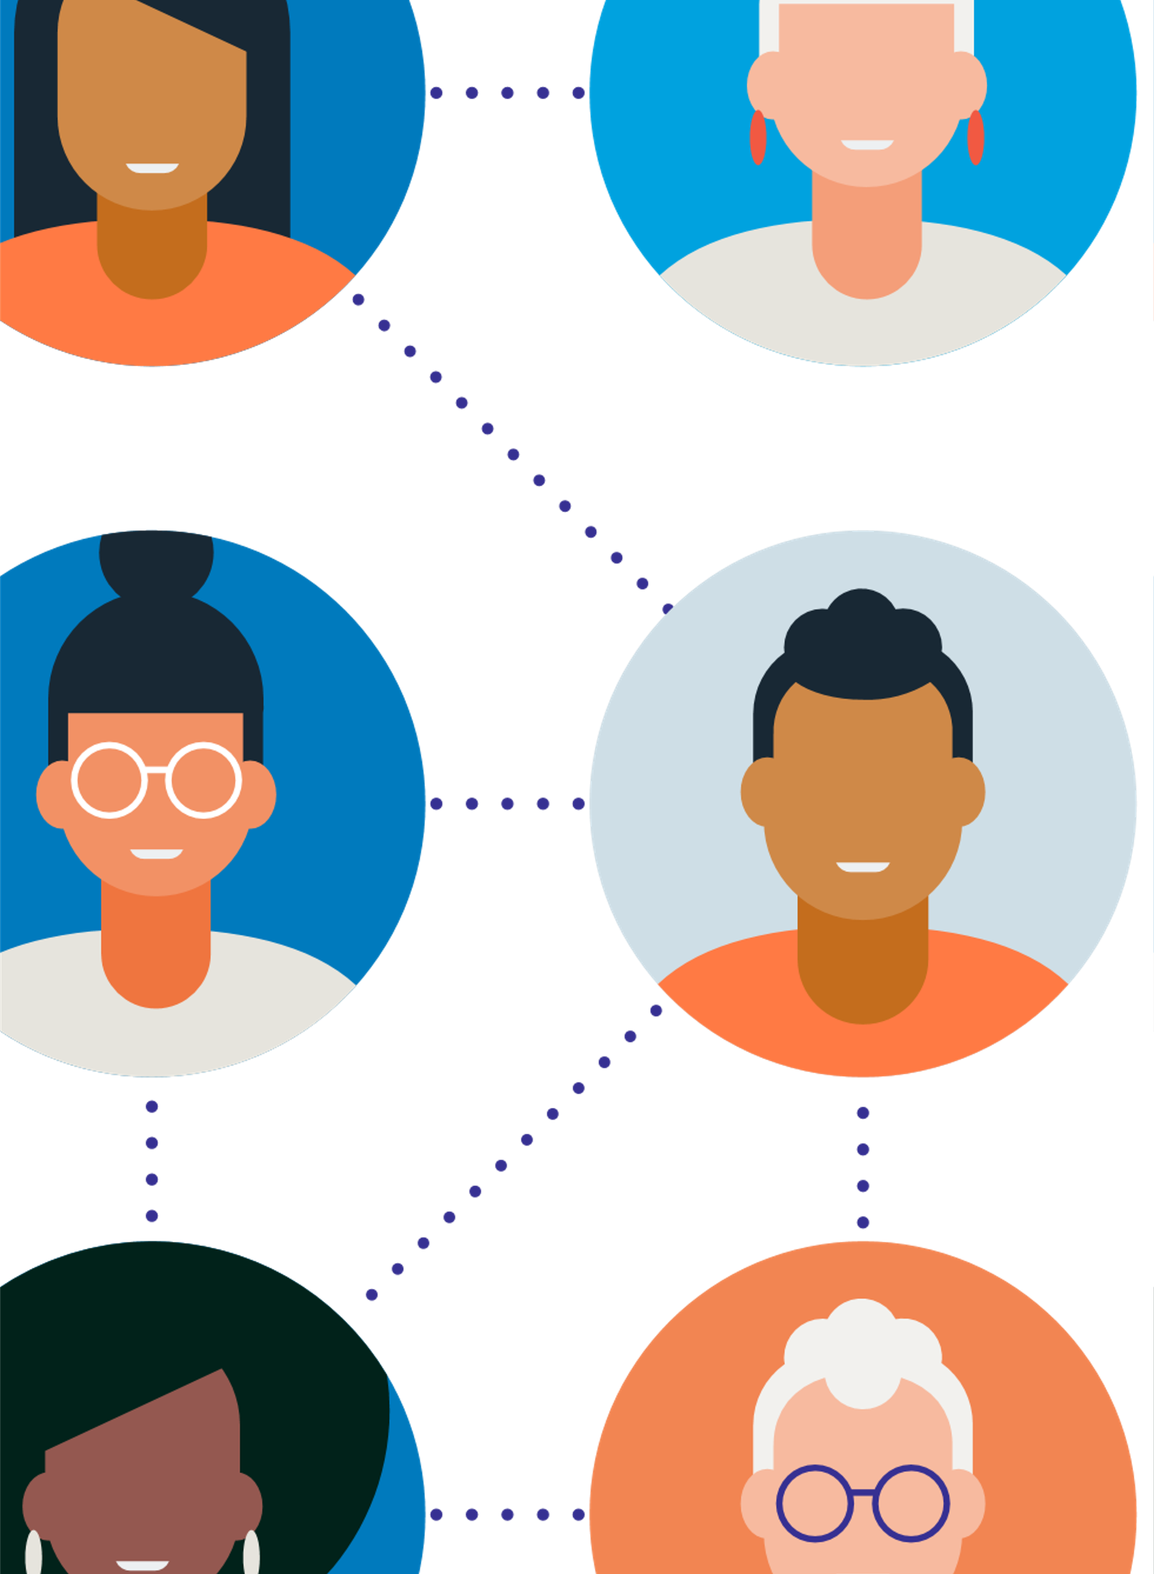
Thank you

